Slide 1

JC2001 Introduction to Software Engineering
Lecture 11: Component, Interface, Performance & Acceptance testing
Dr Xiao Li xiao.li@abdn.ac.uk (BSc Artificial Intelligence)
Dr Huang Yongchao yongchao.huang@abdn.ac.uk (BSc Business Management and Information Systems)
Dr Edward Chuah thuan.chuah@abdn.ac.uk (BSc Computing Science)

Slide 2
Learning objectives
Understand the stages of testing from testing during development to acceptance testing by customers.
Discuss techniques that help you choose test cases that are geared towards discovering program defects.
Understand test-first development.
Discuss three distinct approaches of testing.
Compare between development testing and user testing.
Reference: Ian Sommerville, Software Engineering – Chapter 8 Software Testing, 10th edition, Pearson, 2015.

Slide 3
Outline of lecture
Describe component testing.
Describe interface testing.
Introduce test-first development.
Describe performance testing and acceptance testing.

Slide 4
Component testing
Software components are often made up of several interacting objects. You access the functionality of these objects through component interfaces.
Testing composite components should therefore focus on showing that the component interface or interfaces behave according to specification.
At this point of the testing process, you can assume that unit tests on the individual objects within the component have been completed.

Slide 5
Types of interface errors
There are different types of interfaces between program components and, consequently, different types of interface errors that can occur:
Parameter interfaces. These are interfaces in which data or sometimes function references are passed from one component to another. Methods in an object have a parameter interface.
Shared memory interfaces. These are interfaces in which a block of memory is shared between components. Data is placed in memory by one component and retrieved from there by other components. Commonly used in embedded systems, e.g., sensors that generate data that is retrieved and processed by other system components.

Slide 6
Types of interface errors
There are different types of interfaces between program components and, consequently, different types of interface error that can occur (cont’d):
Procedural interfaces. These are interfaces in which one component encapsulates a set of procedures that can be called by other components.
Message passing interfaces. These are interfaces in which one component requests a service from another component by passing a message to it. A return message includes the results of executing the service. Commonly found in client-server systems, service-oriented architectures.

Slide 7
Mock quiz
Consider 2 functions as shown below:
What problems will arise from using this code?
double square(double x) {
return (x*x);
}
int double_square(int y) {
double s1 = square(y);
double s2 = square(y);
return (s1 * s2);
}
Notes:
Error in the precision of the value returned by the function double_square(). Function square() returns a double. Function double_square() returns an integer value. If the compiler automatically casts the return value of double_square(), then it can result in a loss of precision.

Slide 8
Classes of errors
Interface errors fall into three groups:
Interface misuse. A calling component calls some other component and makes an error in the use of its interface. This type of error is common in parameter interfaces, where parameters may be of the wrong type or be passed in the wrong order, or the wrong number of parameters may be passed.
Interface misunderstanding. A calling component misunderstands the specification of the interface of the called component and makes assumptions about its behaviour. For example, a binary search method may be called with a parameter that is an unordered array. The search would then fail.
Timing errors. These occur in real-time systems that use a shared memory or a message passing interface. The producer of data and consumer of data operate at different speeds. The consumer can access out-of-date information because the producer of the information has not updated the shared interface specification.

Slide 9
General guidelines for interface testing
Some general guidelines for interface testing are:
Examine the code to be tested and identify each call to an external component. Design a set of tests in which the values of the parameters to the external components are at the extreme ends of their ranges. These are most likely to reveal interface inconsistencies.
Where pointers are passed across an interface, always test the interface with null pointer parameters.
Where a component is called through a procedural interface, design tests that deliberately cause the component to fail.
Use stress testing in message passing systems. This means you should design tests that generate many more messages than are likely to occur in practice. This is an effective way of revealing timing problems.

Slide 10
General guidelines for interface testing
Some general guidelines for interface testing are (cont’d):
When several components interact through shared memory, design tests that vary the order in which these components are activated. These tests may reveal implicit assumptions made by the programmer about the order in which the shared data is produced and consumed.

Slide 11
System testing
System testing involves integrating components to create a version of the system and then testing the integrated system. System testing checks that components are compatible, interact correctly, and transfer the right data at the right time across their interfaces. It overlaps with component testing, but there are two differences:
During system testing, reusable components that have been separately developed and off-the-shelf systems may be integrated with newly developed components. The complete system is then tested.
Components developed by different team members or subteams may be integrated at this stage. System testing is a collective rather than an individual process.

Slide 12
System testing
System testing focus on testing the interactions between the components and objects that make up the system. This interaction testing should discover component bugs that are only revealed when a component is used by other components in the system. Because of its focus on interactions, use-case based testing is an effective approach to system testing. Testing the use cases forces these interactions to occur.

Slide 13
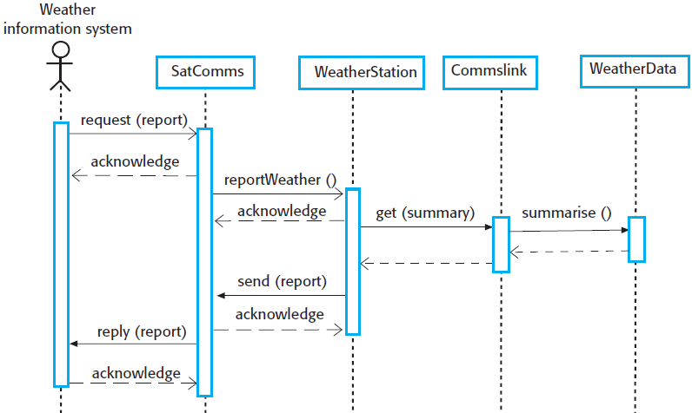
Wilderness station example
You can use this sequence diagram to identify operations that will be tested and to help design the test cases to execute the tests.
For example, issuing a request for a report will result in the execution of the following thread of methods:

Slide 14
Wilderness station example
The sequence diagram helps you to design the specific test cases, as it shows what inputs are required and what outputs are created:
An input of a request for a report should have an associated acknowledgement. A report should ultimately be returned from the request. During testing, you should create summarised data that can be used to check that the report is correctly organised.

Slide 15
Wilderness station example
The sequence diagram helps you to design the specific test cases, as it shows what inputs are required and what outputs are created (cont’d):
An input request for a report to WeatherStation results in a summarised report being generated. You can test this in isolation by creating raw data corresponding to the summary that you have prepared for the test of SatComms and checking that the WeatherStation object correctly produces this summary.

Slide 16
Guidelines for choosing test cases
Exhaustive testing, where every possible program execution sequence is tested, is impossible. Thus, testing has to be based on a subset of possible test cases. Some software companies have policies for choosing this subset. Some guidelines for choosing a subset of test cases include:
All system functions that are accessed through menus should be tested.
Combinations of functions that are accessed through the same menu must be tested.
Where user input is provided, all functions must be tested with both correct and incorrect input.

Slide 17

Mock quiz
You work as a software tester in company ABC and you are tasked to develop a test case to test the security of the ``username’’ input box. Develop a test case and test the security of the username input box. Discuss with your friend(s).
Reference: https://xkcd.com/327/

Slide 18
Test-driven development
Test-driven development (TDD) is an approach to program development in which you interleave testing and code development.
You develop code incrementally, along with a set of tests for that increment. You don’t start working on the next increment until the code that you have developed passes all of its tests.
TDD was introduced as part of the XP agile development method. However, it has now gained mainstream acceptance and may be used in both agile and plan-based approaches.

Slide 19
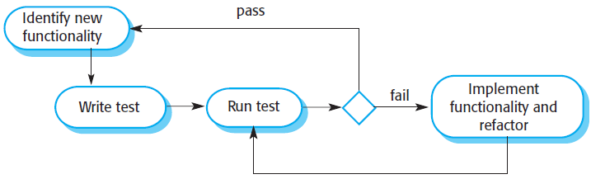
TDD process
The steps in the process are as follows:
Start by identifying the increment or functionality that is required. This should normally be small and implementable in a few lines of code.
Write a test for this functionality and implement it as an automated test. This means that the test can be executed and will report whether or not it has passed or failed.
Run the test, along with all other tests that have been implemented. Initially, you have not implemented the functionality, so the new test will fail. This is deliberate as it shows that the test adds something to the test set.
Implement the functionality and re-run the test. This may involve refactoring existing code to improve it and add new code to what’s already there.
Once all tests run successfully, move on to implement the next chunk of functionality.

Slide 20
Benefits of test-driven development
The benefits of TDD are:
Code coverage. In principle, every code segment that you write should have at least one associated test. Thus, you can be confident that all of the code in the system has actually been executed. Code is tested as it is written, so defects are discovered early in the development process.
Regression testing. A test suite is developed incrementally as a program is developing. You can always run regression tests to check that changes to the program have not introduced new bugs.
Simplified debugging. When a test fails, it should be obvious where the problem lies. The newly written code needs to be checked and modified. You do not need to use debugging tools to locate the problem.
System documentation. The tests themselves act as a form of documentation that describe what the code should be doing. Reading the tests can make it easier to understand the code.

Slide 21
Performance testing
Once a system has been completely integrated, it is possible to test for emergent properties, such as performance and reliability. Performance tests have to be designed to ensure that the system can process its intended load. This usually involve running a series of tests where you increase the load until the system performance becomes unacceptable. This approach is also known as stress testing.
Stress testing helps to:
Test the failure behaviour of the system. Stress testing checks that overloading the system causes it to ``fail-soft’’ rather than collapse under its load.
Reveal defects that only show up when the system is fully loaded. Although it can be argued that these defects are unlikely to cause system failures in normal use, there may be unusual combinations of circumstances that the stress testing replicates.

Slide 22
User testing
User or customer testing is a stage in the testing process in which users or customers provide input and advice on system testing. There are three types of user testing:
Alpha testing, where a selected group of software users work closely with the development team to test early releases of the software.
Beta testing, where a release of the software is made available to a larger group of users to allow them to experiment and to raise problems that they discover with the system developers.
Acceptance testing, where customers test a system to decide whether or not it is ready to be accepted from the system developers and deployed in the customer environment.

Slide 23
Alpha testing
In alpha testing, users and developers work together to test a system as it is being developed. This means that the users can identify problems and issues that are not readily apparent to the development testing team.
Alpha testing is often used when developing software products, e.g., computer games, or apps. Experienced users of these products may be willing to get involved in the alpha testing process because it gives them early information about new system features that they can exploit. It also reduces the risk that unanticipated changes to the software will have disruptive effects on their business.

Slide 24
Beta testing
Beta testing takes place when an early, sometimes unfinished, release of a software system is made available to a larger group of customers and users for evaluation. Beta testers may be a selected group of customers who are early adopters of the system. Alternatively, the software may be made publicly available for use by anyone who is interested in experimenting with it.

Slide 25
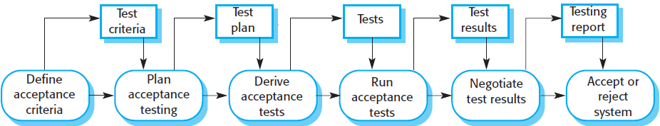
Acceptance testing
Acceptance testing is an inherent part of custom systems development. Customers test a system, using their own data, and decide if it should be accepted from the system developer. Acceptance implies that final payment should be made for the software.

Slide 26
Stages in the acceptance testing process
There are six stages in the acceptance testing process:
Define acceptance criteria. This stage should ideally take place early in the process before the contract for the system is signed.
Plan acceptance testing. This stage involves deciding on the resources, time, and budget for acceptance testing and establishing a testing schedule.
Derive acceptance tests. Once the acceptance criteria have been established, tests have to be designed to check whether or not a system is acceptable. Acceptance tests should aim to test both the functional and non-functional requirements.
Run acceptance tests. The agreed acceptance tests are executed on the system.

Slide 27
Stages in the acceptance testing process
There are six stages in the acceptance testing process (cont’d):
Negotiate test results. It is unlikely that all of the defined acceptance tests will pass and that there will be no problems with the system. If this is the case, then acceptance testing is complete and handed over. However, some problems will be discovered, so the customer and developer have to negotiate to decide if the system is good enough to be used.
Reject / accept system. This stage involves a meeting between the developers and the customer to decide on whether or not the system should be accepted. If the system is not good enough for use, then further development is required to fix the identified problems. Once complete, the acceptance testing phase is repeated.

Slide 28
Lessons learned
Testing can only show the presence of errors in a program. It cannot show that there are no remaining faults.
Development testing is the responsibility of the software development team. A separate team should be responsible for testing a system before it is released to customers. In the user testing process, customers or system users provide test data and check that tests are successful.
Development testing includes unit testing in which you test individual objects and methods, component testing in which you test related groups of objects, and system testing in which you test partial or complete systems.

Slide 29
Lessons learned
Test-first development is an approach to development where tests are written before the code is to be tested. Small code changes are made, and the code is refactored until all tests execute successfully.
Acceptance testing is a user testing process in which the aim is to decide if the software is good enough to be deployed and used in its planned operational environment.

